Slide 1

Multi-Factor based Nutrition Management System and Recipe Recommendation System
Project Work - CSP Final CIE Evaluation
Department of Computer Science and Engineering
Team:
1MS18CS025 Aravind Shreyas Ramesh
1MS18CS040 Dheeraj Bhat
1MS18CS043 Divya
1MS18CS046 Gaurav V
Guide:
Dr Shilpa Shashikant Chaudhari
Associate Professor
Computer Science and Engineering

Slide 2
Agenda
Introduction
Motivation
Problem Statement
Literature Survey
System Requirements
Proposed Methodology
Implementation
Results and Analysis
Conclusion

Slide 3
Introduction
Nutrition is the supply of food that human beings need to feed our cells and keep them alive. Nutrients can be obtained from products such as vitamin supplements.
Without nutrition, humans grow weak, sick and at the very worst can even die. Humans miss developmental milestones and can’t put their bodies through the daily mental and physical tasks that one needs them to.
Recipe recommendation involves taking various types of inputs such as nutritional values or ingredients or preferences and suggesting/ranking relevant food products and recipes as outputs.
This project aims to detect nutritional shortcomings of a user by taking various inputs that can easily be obtained through standard blood tests and overcome deficiencies if detected by recommending food and recipes using an intelligent algorithm.

Slide 4
Motivation
This research is in collaboration with TDU and takes the form of a funded project.
There is requirement of nutrition deficiency aware recipe recommendation system for nutrition experts or researcher wherein it uses standard database, which is developed as part of consultancy project at CSE, RIT.
This project attempts to develop such system which may be used nutrition expert it also tries to include features for smart chef in Indian kitchen, who may or may not consult nutrition expert but want to have healthy life.
Lack of existing research in the domain of recipe recommendation based on nutrition analysis based on an individual’s food consumption and nutritional profile.
Ever-growing consciousness amongst individuals to understand their nutritional deficiency and follow a personalized healthy diet.

Slide 5
Problem Statement
Nutrient management in the context of this project aims to quantize the consumption of essential nutrients in an efficient format such that it leads to a healthy and balanced lifestyle. Several recent studies have shown the importance of quality-based consumption of nutrients which could otherwise lead to serious health issues that could even be fatal at times.
Increased consciousness towards one’s health has recently been in the limelight which creates the need for an intelligent system specially customized for the individual that can analyse the person’s consumption quality and suggest options that could essentially fulfil their body’s need to lead a healthy lifestyle.
The presence of this particular system can hugely impact individuals as this would save a considerable amount of time in finding a recipe that would not only suit the user’s preference but also encapsulate all the nourishing factors that an individual would require.

Slide 6
Literature Survey / Related Works
Title and Author | Technique Used | Result | Advantages and Disadvantages
Personalized Ubiquitous Diet Plan service based on ontology and web services, by Chuan-Jun Su, Yin-An Chen, and Chia-Wen Chih. | Diet-Aid Ontological Knowledge Engine (DOKE) | Diet-Aid was developed and deployed using the Restful architecture, allowing for ubiquitous access via any Internet-enabled device. | Advantages: The system adds nutrition information about the ingredients, such as number of vitamins in the ingredients for users to consider. Drawbacks: The system could be further enhanced by generating a diet plan by putting the nutritionist recommended daily intakes into consideration.
Food Recommendation with Graph Convolutional Network, by Gao, Xiaooyan & Feng, Fuli & Huang, Heyan & Mao, Xian-Ling & Lan, Tian & Chi, Zewen. | Graph Convolutional Network (FGCN), which exploits ingredient-ingredient, ingredient-recipe, and recipe-user relations deeply. | The proposed FGCN outperforms the state-of-the-art baselines. Further in-depth analyses reveal that FGCN could alleviate the sparsity issue in food recommendation. | Advantages: Does not overlook the various food-related relations, especially the ingredient-ingredient relations, leading to comprehensive representations. Drawbacks: The standard nutritional values are not considered.
The nature and evolution of online food preferences, by Wagner, Claudia & Singer, Philipp & Strohmaier, Markus. | Visualisations of intrinsic statistical properties from a new source of data, i.e., server log data from a large recipe platform on the World Wide Web, and explore its usefulness for understanding online food preferences. | Recipe preference distributions exhibit more regional differences than ingredient preference distributions. Recipe preferences are partly driven by ingredient preferences and weekday preferences are clearly distinct from weekend preferences. | Advantages: Presents a comprehensive multi-dimensional approach which allows to dig into the nature and evolution of users’ online food preferences.

Slide 7
Literature Survey / Related Works
Title and Author | Technique Used | Result | Advantages and Disadvantages
Automated and Personalized Nutrition Health Assessment, Recommendation, and Progress Evaluation using Fuzzy Reasoning, by Salloum, George & Tekli, Joe. | Recommender system using Fuzzy Reasoning | Results show that recommendations are on a par with and sometimes surpass those of human nutritionists. | Advantage : Performs meal planning with performing health state assessment or evaluation. Drawback : There is a lack of personalisation to user to make it applicable to real-world.
Hierarchical Attention Network for Visually-Aware Food Recommendation, by Gao, Xiaooyan & Feng, Fuli & He, Xiangnan & Huang, Heyan & Guan, Xinyu & Feng, Chong & Ming, Zhaoyan & Chua, Tat-Seng. | Hierarchical Attention Network | Outperforms several competing recommender solutions like Factorization Machine and Visual Bayesian Personalized Ranking with an average improvement of 12%. | Advantage : Builds comprehensive recipe representation via jointly leveraging user-recipe interaction history, food image, and food ingredients with a hierarchical attention. Drawback : Does not incorporate user's health and nutritional requirements, no relations drawn between various ingredients, does not consider users' physical profile when recommending recipes.
References.
The system considers standard nutritional values related to gender and age along with nutritional information including deficiencies which makes are system unique to existing models.
The nutritional profile analysis and recipe recommendation is bundled into one functional system making it the novel feature of this project.

Slide 8
System Requirements
Hardware Requirements
Any mobile or personal computing device which has the following basic specifications.
CPU: Any modern 64-bit processor
RAM: 3 GB or more
Storage: 1 GB, Additional space recommended
GPU: integrated GPUs or higher
Internet access and support
Software Requirements
Works with any of the latest operating systems like Windows 8 – 11, Linux, MacOS, Android, iOS

Slide 9
System Requirements
Functional Requirements
A fully functional system capable of suggesting recipes based on users’ nutritional requirements and preferences.
Verified authentication system to secure user’s data against theft.
Attractive and simple UI/UX for interaction.
Inputs from the user about their nutritional profile and their preferences.
User systems capable of handling and running complex mathematical tasks on-premise.
Non-Functional Requirements
Reliable application with strong recovery pipelines when an error is encountered.
Scalable application as the user base grows.
Consistent responses for similar inputs.
Traceable solution for logging mechanisms.

Slide 10
Data Flow Diagram
Diagram

Slide 11
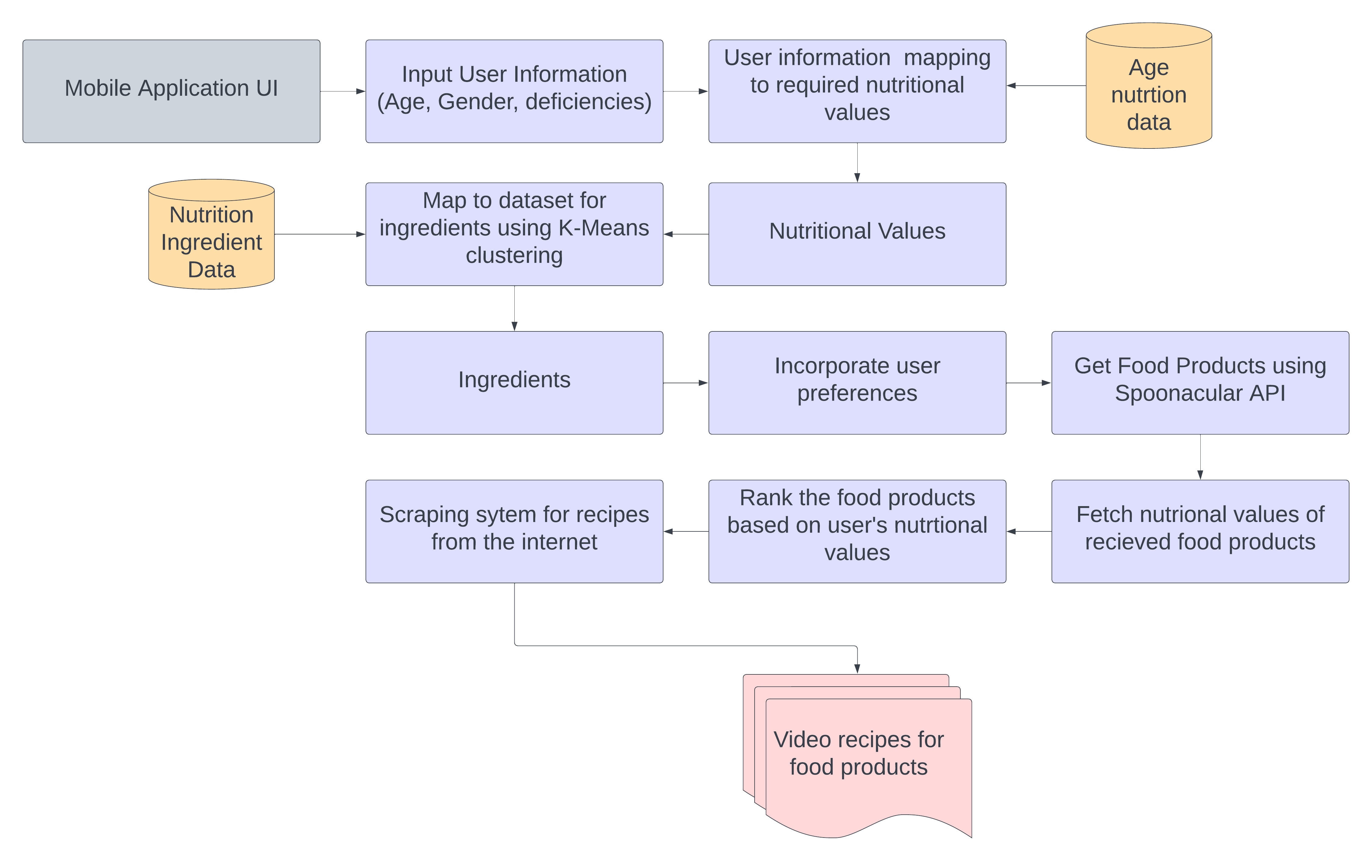
Approach / Solution
Fig. 1. High Level Design

Slide 12
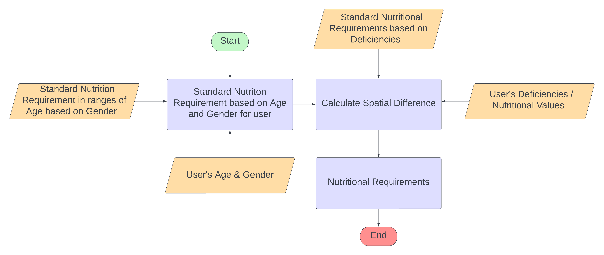
Approach / Solution
Low level Design
Pseudo-Code
function nutritionalRequirements(age, gender, profile) {
Compare user's profile to standard values for the age range and gender.
Calculate deficiencies (spatial difference)
return deficiencies.
}
Fig. 2. Comparing standard nutrition values and user’s nutrition values to detect deficiencies

Slide 13
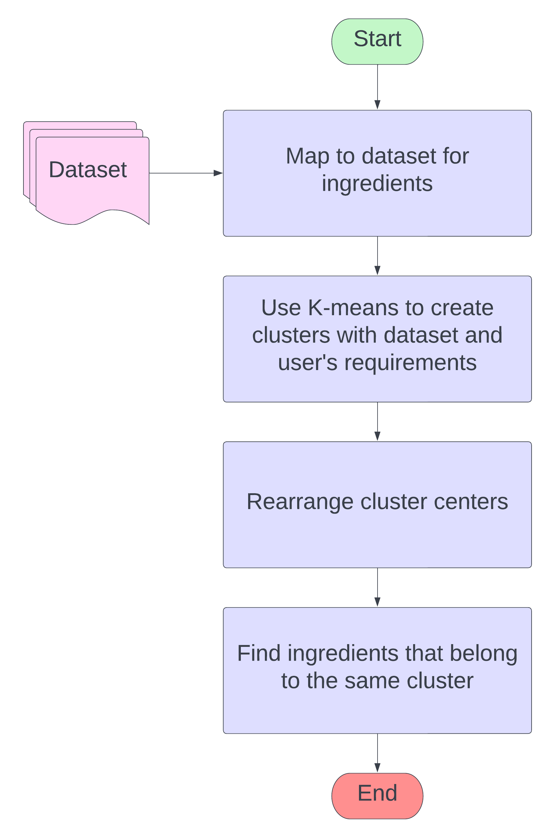
Approach / Solution
Low level Design
Pseudo-Code
function getIngredients(deficiencies) {
Append deficiency to dataset.
Use K-Means to cluster.
Rearrange cluster centers.
Get closest ingredients
return ingredients
}
Fig. 3. Detecting ingredients required for the user

Slide 14
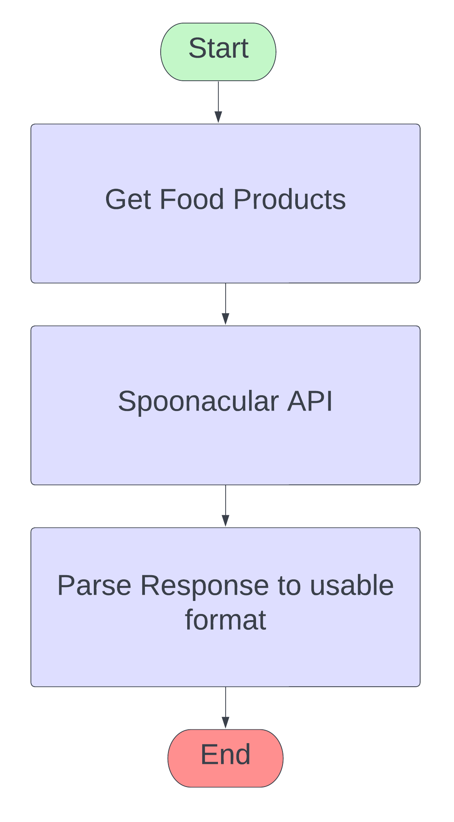
Approach / Solution
Low level Design
Pseudo-Code
function getFoodProducts(ingredients) {
Call Spoonacular to get food products for given ingredients.
Parse response received from the upstream call.
return parsed response
}
Fig. 4. Obtaining foods with the specific set of ingredients

Slide 15
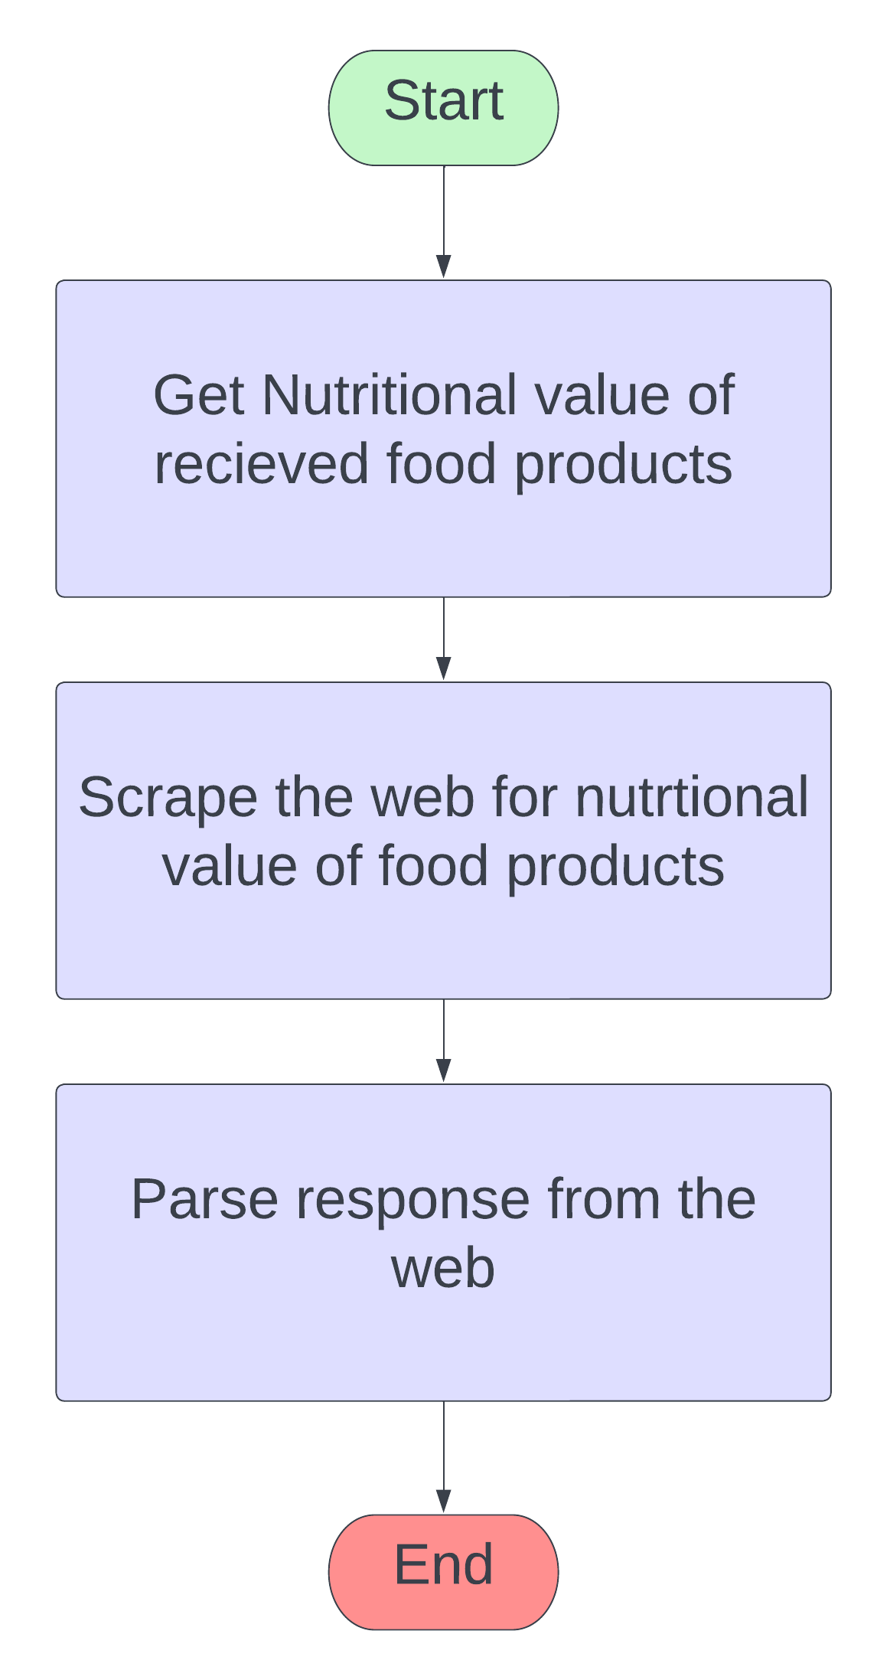
Approach / Solution
Low level Design
Pseudo-Code
function getNutritionalValueAndRank(parsedResponse) {
Get nutritional values for each of the food products in the parsedResponse.
Rank foodProducts based on nutritional requirements(spatial).
return rankedFoodProducts
}
Fig. 5. Scraping nutritional value of cooked products

Slide 16
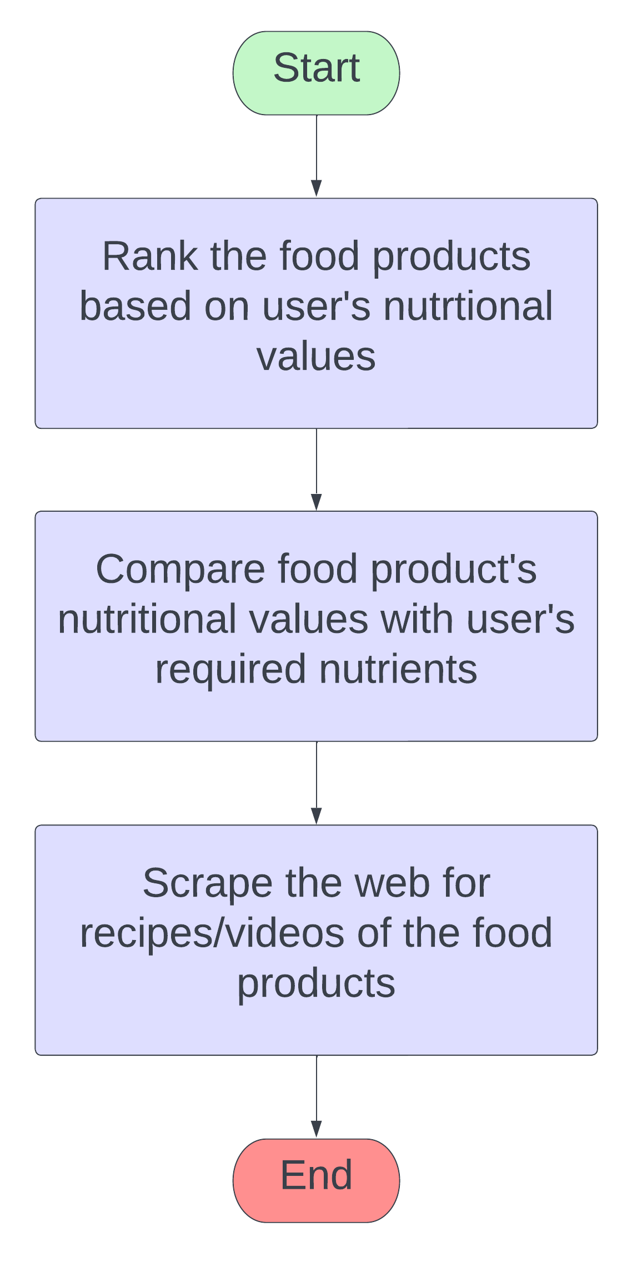
Approach / Solution
Low level Design
Pseudo-Code
function getRecipes(rankedProducts) {
Query YouTube for recipes for each of the rankedFoodProducts.
return videoLists.
}
Fig. 6. Obtaining best recommendations for user

Slide 17
Implementation

Slide 18
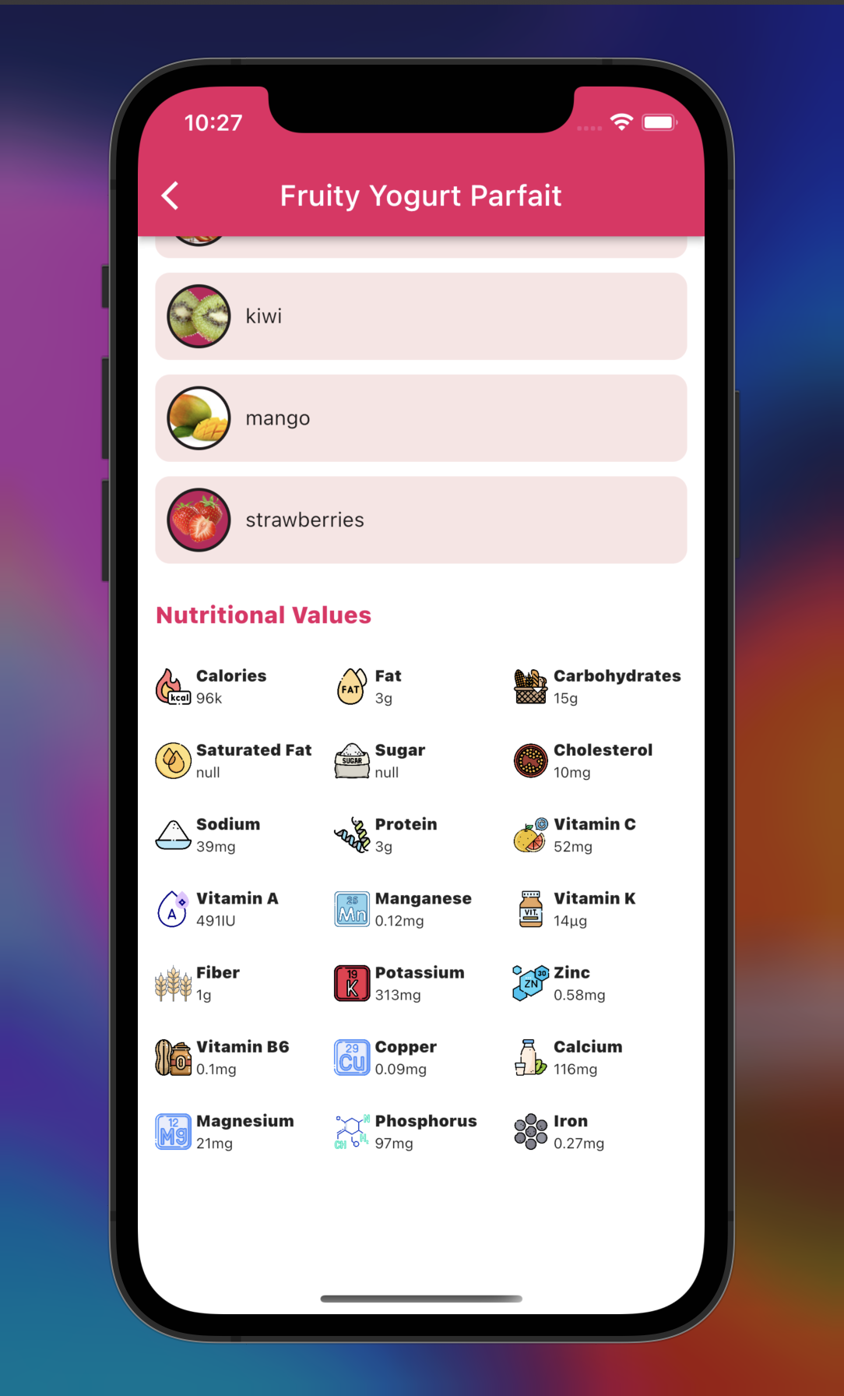
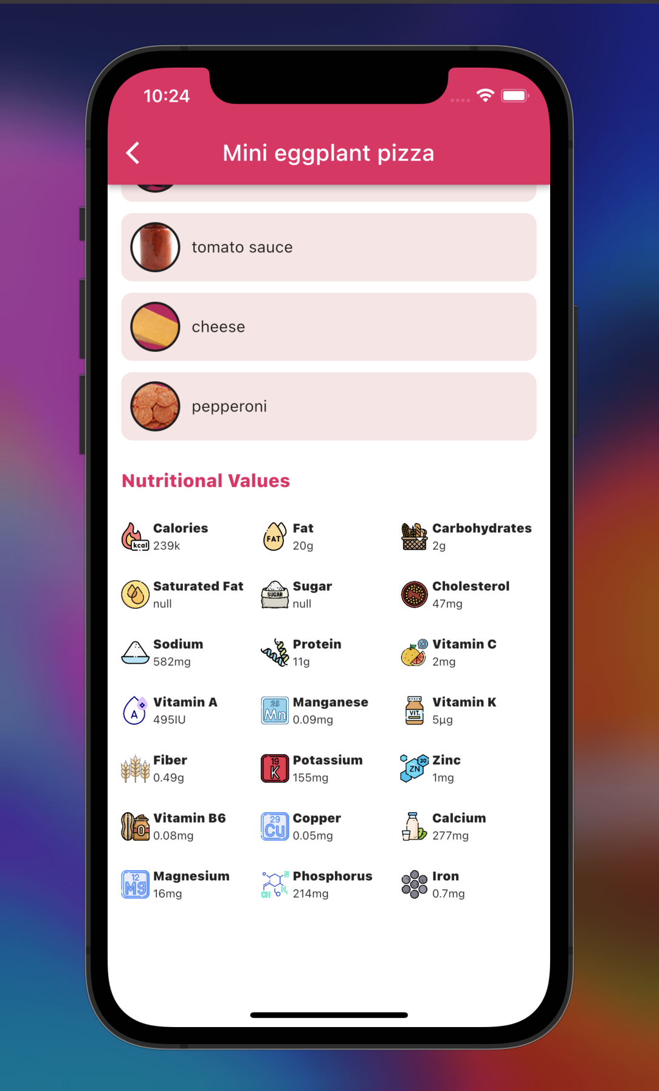
Results / Findings
Fig. 7 captures one of the food products suggested to an input with high calorie value (550kcal). The output is a food product with much lesser calories (96kcal) way below the standard(290kcal)
Fig. 8 captures one of the food products
suggested to an input with low protein value (3g). The output is a food product with higher amounts of protein (11g) for a meal.
Fig. 7. Fruity Yogurt Parfait Recipe (carbs)
Fig.8. Mini eggplant pizza
(protein)

Slide 19
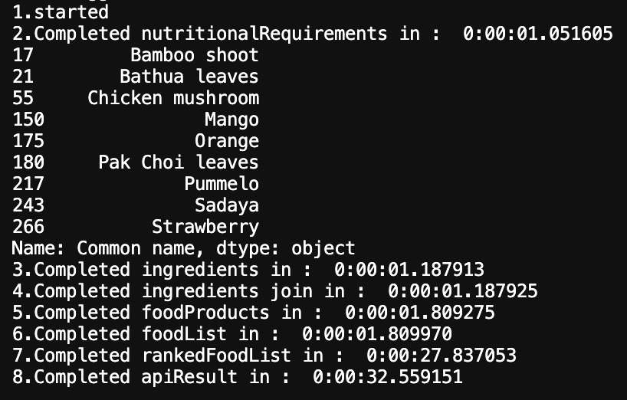
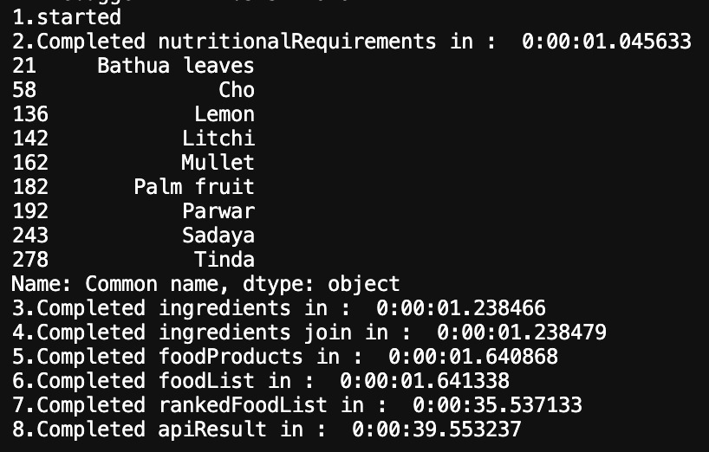
Results / Findings
Fig. 9. Results from K-Means Clustering
Fig.10. Results from K-Means Clustering
Fig. 9 and 10 contain sample ingredients suggested for different inputs from the user.

Slide 20
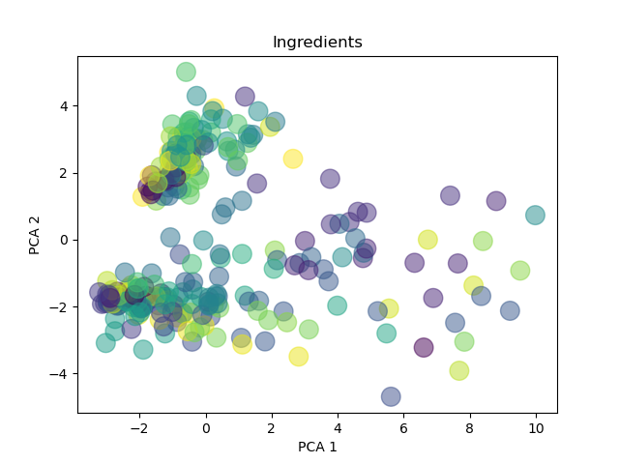
Results / Findings
Fig. 10. Results from K-Means Clustering

Slide 21
Deliverables
A proof of concept and an algorithm for TDU to work on the initial findings from the research.
A working application to showcase the effectiveness of the solution provided.

Slide 22
Novelty / Contribution
Research considers clustering based on ingredients for all forms of nutritional requirements. Existing researches focus on either food products or specific nutritional requirements.
The research becomes a platform for TDU to build a real-time deployable product that utilizes the research findings as the underlying solution.
An application to demo the solution built which can be used by a subset of the stakeholders.

Slide 23
Conclusion
A solution was provided which revolves around identifying deficiencies, building clusters to identify required ingredients, assemble food products and rank them according to the user's needs.
An application was built to verify the solution in real-time.
The project will be handed over to TDU who will build on the existing solution.

Slide 24
References
Chuan-Jun Su, Yin-An Chen, and Chia-Wen Chih. (2013). Personalized Ubiquitous Diet Plan service based on ontology and web services. http://www.ijiet.org/papers/329-K012.pdf
Gao, Xiaooyan & Feng, Fuli & Huang, Heyan & Mao, Xian-Ling & Lan, Tian & Chi, Zewen. (2021). Food Recommendation with Graph Convolutional Network. Information Sciences. 584. 10.1016/j.ins.2021.10.040.
Wagner, Claudia & Singer, Philipp & Strohmaier, Markus. (2014). The nature and evolution of online food preferences. EPJ Data Science. 3. 10.1140/epjds/s13688-014-0036-7.
Salloum, George & Tekli, Joe. (2021). Automated and Personalized Nutrition Health Assessment, Recommendation, and Progress Evaluation using Fuzzy Reasoning. International Journal of Human-Computer Studies. 151. 102610. 10.1016/j.ijhcs.2021.102610.
Gao, Xiaooyan & Feng, Fuli & He, Xiangnan & Huang, Heyan & Guan, Xinyu & Feng, Chong & Ming, Zhaoyan & Chua, Tat-Seng. (2019). Hierarchical Attention Network for Visually-Aware Food Recommendation. IEEE Transactions on Multimedia. PP. 1-1. 10.1109/TMM.2019.2945180.

Slide 25
Thank You

